Slide 1
Deadlock-02

Slide 2
Banker’s Algorithm
Multiple instances
Each process must a priori claim maximum use
When a process requests a resource it may have to wait
When a process gets all its resources it must return them in a finite amount of time

Slide 3
Data Structures for the Banker’s Algorithm
Let n = number of processes, and m = number of resources types.
Available: Vector of length m. If available [j] = k, there are k instances of resource type R_{j} available
Max: n x m matrix. If Max [i,j] = k, then process P_{i} may request at most k instances of resource type R_{j}
Allocation: n x m matrix. If Allocation[i,j] = k then P_{i} is currently allocated k instances of R_{j}
Need: n x m matrix. If Need[i,j] = k, then P_{i} may need k more instances of R_{j} to complete its task
Need [i,j] = Max[i,j] – Allocation [i,j]

Slide 4
Safety Algorithm
1. Let Work and Finish be vectors of length m and n, respectively. Initialize:
Work = Available
Finish [i] = false for i = 0, 1, …, n- 1
2. Find an i such that both:
(a) Finish [i] = false
(b) Need_{i} ≤ Work
If no such i exists, go to step 4
3. Work = Work + Allocation_{i} Finish[i] = true go to step 2
4. If Finish [i] == true for all i, then the system is in a safe state

Slide 5
Example of Banker’s Algorithm
5 processes P₀ through P₄;
3 resource types:
A (10 instances), B (5 instances), and C (7 instances)
Snapshot at time T₀:
Allocation Max Available
A B C A B C A B C
P₀ 0 1 0 7 5 3 3 3 2
P₁ 2 0 0 3 2 2
P₂ 3 0 2 9 0 2
P₃ 2 1 1 2 2 2
P₄ 0 0 2 4 3 3

Slide 6
Example (Cont.)
The content of the matrix Need is defined to be Max – Allocation
Need
A B C
P₀ 7 4 3
P₁ 1 2 2
P₂ 6 0 0
P₃ 0 1 1
P₄ 4 3 1

Slide 7
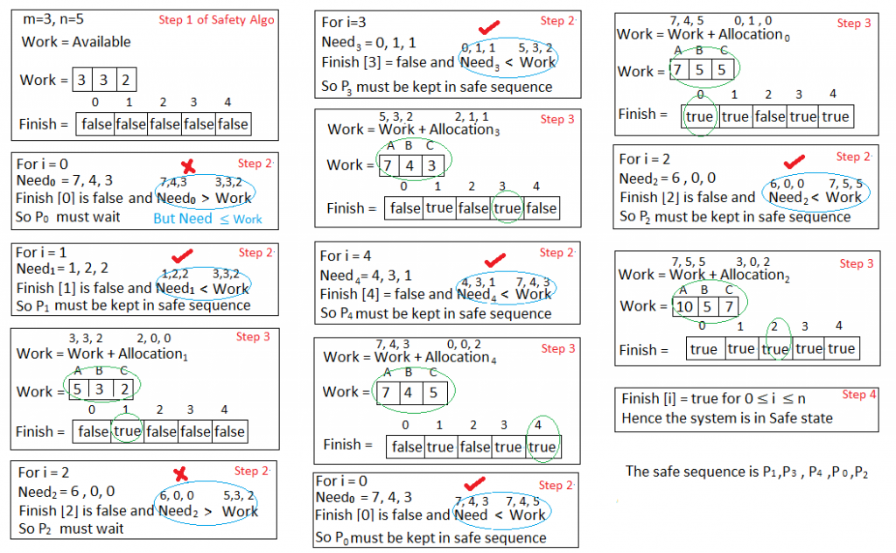
Safety Algorithm Example

Slide 8
Resource-Request Algorithm for Process P_{i}
Request = request vector for process P_{i}. If Request_{i} [j] = k then process P_{i} wants k instances of resource type R_{j}
1. If Request_{i} ≤ Need_{i} go to step 2. Otherwise, raise error condition, since process has exceeded its maximum claim
2. If Request_{i} ≤ Available, go to step 3. Otherwise P_{i} must wait, since resources are not available
3. Pretend to allocate requested resources to P_{i} by modifying the state as follows:
Available = Available – Request;
Allocation_{i} = Allocation_{i} + Request_{i};
Need_{i} = Need_{i} – Request_{i};
If safe ⇒ the resources are allocated to Pi
If unsafe ⇒ Pi must wait, and the old resource-allocation state is restored

Slide 9
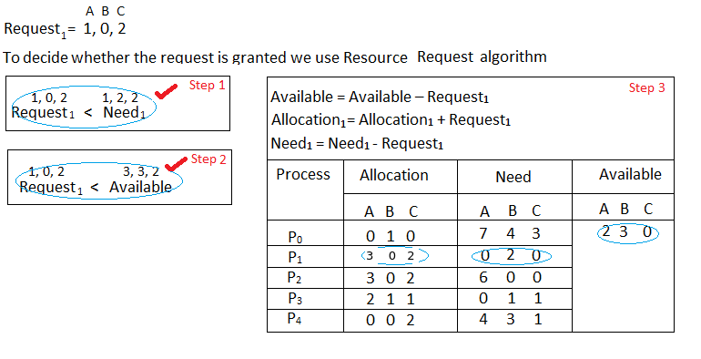
Example: P₁ Request (1,0,2)

Slide 10
Example: P₁ Request (1,0,2)(cont.)
We must determine whether this new system state is safe. To do so, we again execute Safety algorithm on the above data structures.(Showed in next slide)

Slide 11
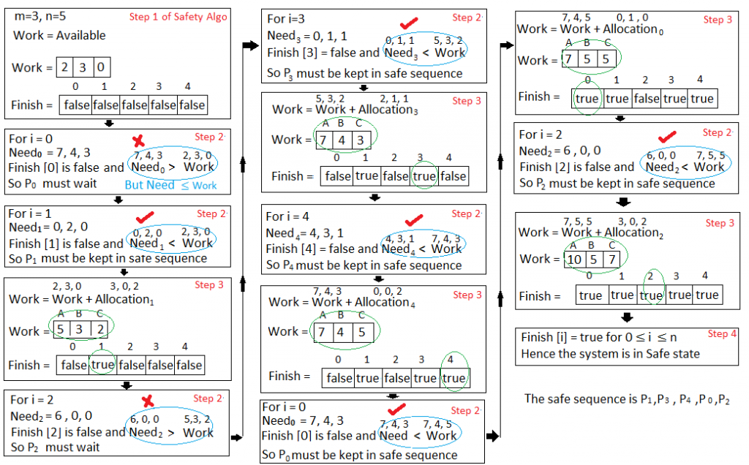
Hence the new system state is safe, so we can immediately grant the request for process P_{1 .}

Slide 12
Exercise
Can request for (3,3,0) by P₄ be granted?
Can request for (0,2,0) by P₀ be granted?

Slide 13
Deadlock Detection
Allow system to enter deadlock state
Detection algorithm
Recovery scheme

Slide 14
Single Instance of Each Resource Type
Maintain wait-for graph
Nodes are processes
P_{i} → P_{j} if P_{i} is waiting for P_{j}
Periodically invoke an algorithm that searches for a cycle in the graph. If there is a cycle, there exists a deadlock
An algorithm to detect a cycle in a graph requires an order of n² operations, where n is the number of vertices in the graph

Slide 15
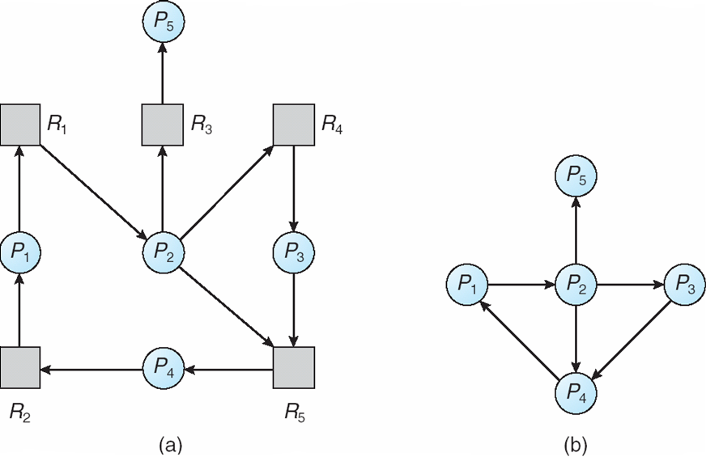
Resource-Allocation Graph and Wait-for Graph
Resource-Allocation Graph
Corresponding wait-for graph

Slide 16
Several Instances of a Resource Type
Available: A vector of length m indicates the number of available resources of each type.
Allocation: An n x m matrix defines the number of resources of each type currently allocated to each process.
Request: An n x m matrix indicates the current request of each process. If Request [i_{j}] = k, then process P_{i} is requesting k more instances of resource type. R_{j}.

Slide 17
Detection Algorithm
1. Let Work and Finish be vectors of length m and n, respectively Initialize:
(a) Work = Available
(b) For i = 1,2, …, n, if Allocation_{i} ≠ 0, then Finish[i] = false;otherwise, Finish[i] = true
2. Find an index i such that both:
(a) Finish[i] == false
(b) Request_{i} ≤ Work
If no such i exists, go to step 4

Slide 18
Detection Algorithm (Cont.)
3. Work = Work + Allocation_{i} Finish[i] = true go to step 2
4. If Finish[i] == false, for some i, 1 ≤ i ≤ n, then the system is in deadlock state. Moreover, if Finish[i] == false, then P_{i} is deadlocked
Algorithm requires an order of O(m x n²⁾ operations to detect whether the system is in deadlocked state

Slide 19
Example of Detection Algorithm
Five processes P₀ through P₄; three resource types A (7 instances), B (2 instances), and C (6 instances)
Snapshot at time T₀:
Allocation Request Available
A B C A B C A B C
P₀ 0 1 0 0 0 0 0 0 0
P₁ 2 0 0 2 0 2
P₂ 3 0 3 0 0 0
P₃ 2 1 1 1 0 0
P₄ 0 0 2 0 0 2

Slide 20
Example of Detection Algorithm(Cont.)
1.In this, Work = [0, 0, 0] & Finish = [false, false, false, false, false]
2.i=0 is selected as both Finish[0] = false and [0, 0, 0]<=[0, 0, 0].
Work =[0, 0, 0]+[0, 1, 0] =>[0, 1, 0] & Finish = [true, false, false, false, false].
3.i=2 is selected as both Finish[2] = false and [0, 0, 0]<=[0, 1, 0].
Work =[0, 1, 0]+[3, 0, 3] =>[3, 1, 3] & Finish = [true, false, true, false, false].
4.i=1 is selected as both Finish[1] = false and [2, 0, 2]<=[3, 1, 3].
Work =[3, 1, 3]+[2, 0, 0] =>[5, 1, 3] & Finish = [true, true, true, false, false].
5.i=3 is selected as both Finish[3] = false and [1, 0, 0]<=[5, 1, 3].
Work =[5, 1, 3]+[2, 1, 1] =>[7, 2, 4] & Finish = [true, true, true, true, false].
6.i=4 is selected as both Finish[4] = false and [0, 0, 2]<=[7, 2, 4].
Work =[7, 2, 4]+[0, 0, 2] =>[7, 2, 6] & Finish = [true, true, true, true, true].
Sequence <P₀, P₂, P₃, P₁, P₄> will result in Finish[i] = true for all i
Since Finish is a vector of all true it means there is no deadlock in this example.

Slide 21
Example of Detection Algorithm(Cont.)
P₂ requests an additional instance of type C
Request
A B C
P₀ 0 0 0
P₁ 2 0 1
P₂ 0 0 1
P₃ 1 0 0
P₄ 0 0 2
State of system?
Can reclaim resources held by process P₀, but insufficient resources to fulfill other processes; requests
Deadlock exists, consisting of processes P₁, P₂, P₃, and P₄

Slide 22
Detection-Algorithm Usage
When, and how often, to invoke depends on:
How often a deadlock is likely to occur?
How many processes will need to be rolled back?
one for each disjoint cycle
If detection algorithm is invoked arbitrarily, there may be many cycles in the resource graph and so we would not be able to tell which of the many deadlocked processes “caused” the deadlock.

Slide 23
Recovery from Deadlock: Process Termination
Abort all deadlocked processes
Abort one process at a time until the deadlock cycle is eliminated
In which order should we choose to abort?
Priority of the process
How long process has computed, and how much longer to completion
Resources the process has used
Resources process needs to complete
How many processes will need to be terminated
Is process interactive or batch?

Slide 24
Recovery from Deadlock: Resource Preemption
Selecting a victim – minimize cost
Rollback – return to some safe state, restart process for that state
Starvation – same process may always be picked as victim, include number of rollback in cost factor

Slide 25
Thank You!

